Slide 1
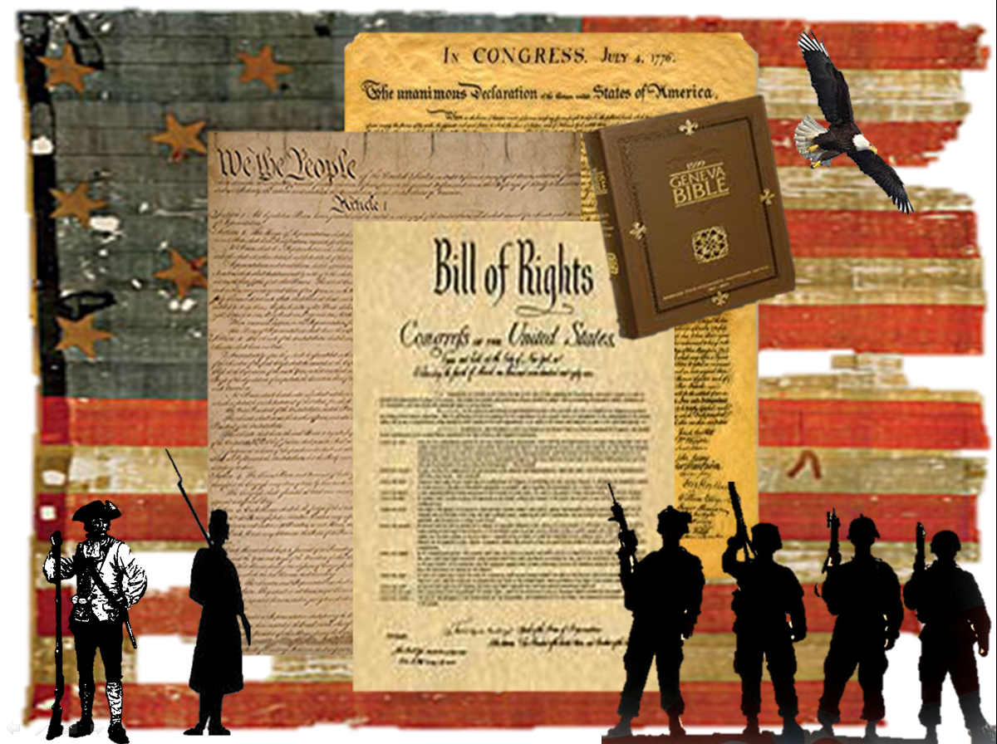
American Patriotism
Club
Mission: To have a deeper respect for American History
Vision: To be an active American citizen.
Time: Thursdays at 12:00 pm
in our “Live” Patriot Club room
Link: https://sas.elluminate.com/m.jnlp?sid=447&password=M.C6DBEE7FF246D079429CFE14BE59E1
This club is for students interested in American History. Discussions will cover our foundation of Judea/Christian beginnings, national heroes, national monuments, and our hidden and/or lost history. All are welcome to rediscover our heritage and reignite the "Patriotism" that is inherently within each of us. Come and discover what makes the United States of America the greatest nation in all of history!

Slide 2

Please Note:
Views expressed in this club are mine and mine alone and are not a part of Virtual Community School of Ohio.

Slide 3
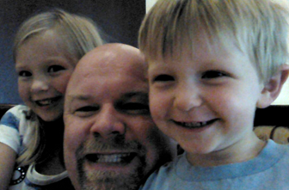
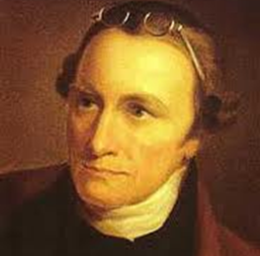
My Reasons for this Group:
I’m a Christian, a Citizen, a Dad, a Son, and a Teacher. I am trying to learn true history to be an active citizen and to follow the principals our Founders set for us through their own examples of self-sacrifice and study of truth. I want to honor God, giver of all things.
"I have but one lamp by which my feet are guided; and that is the lamp of experience. I know of no way of judging the future but by the past."
Patrick Henry
"Those who do not learn from history are doomed to repeat it." George Santayana

Slide 4
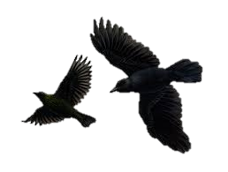
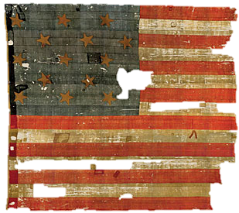
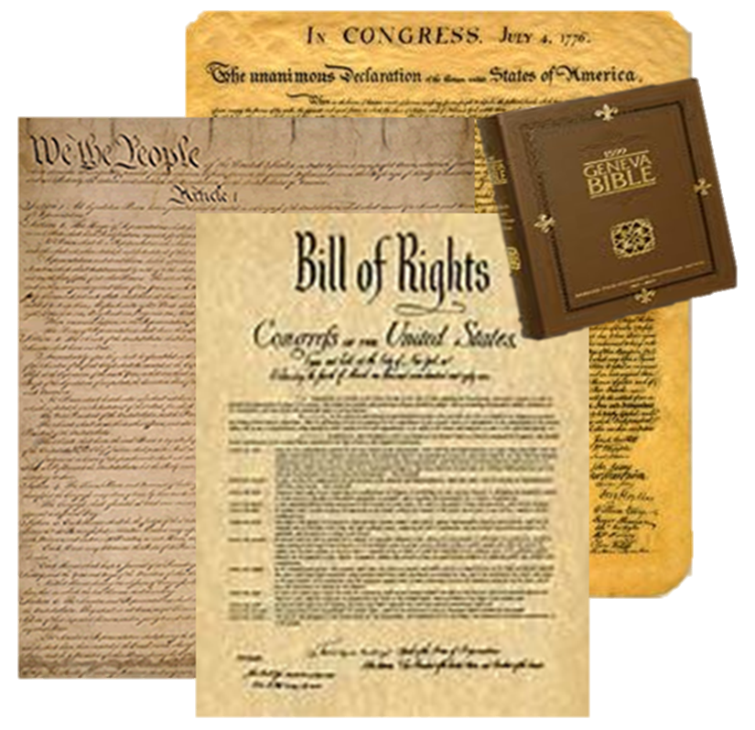
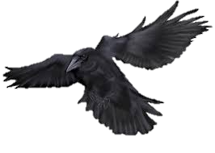
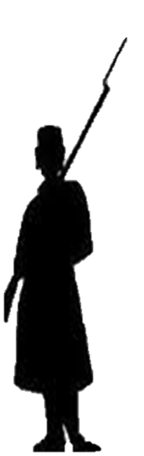

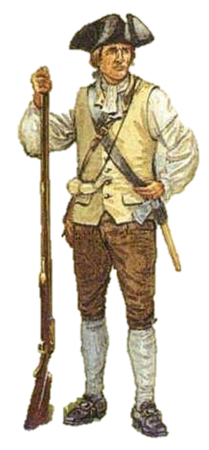
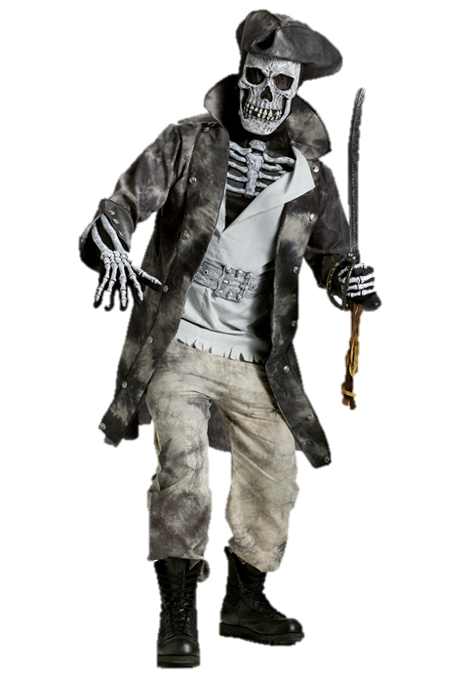
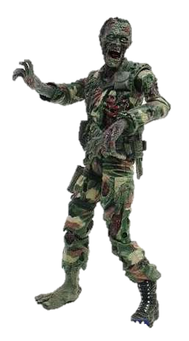
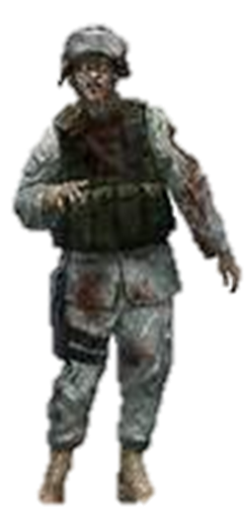
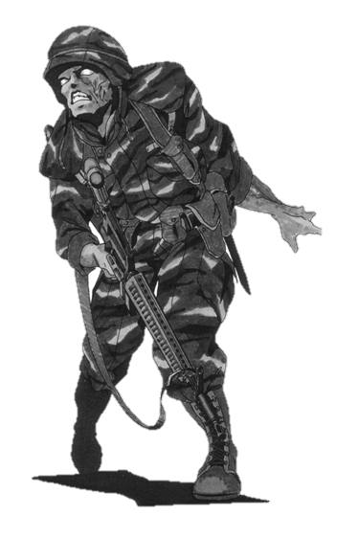
Halloween Edition

Slide 5
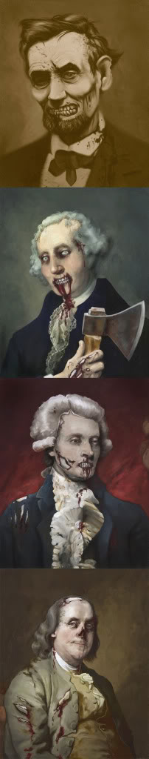
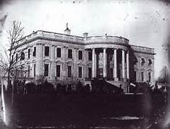
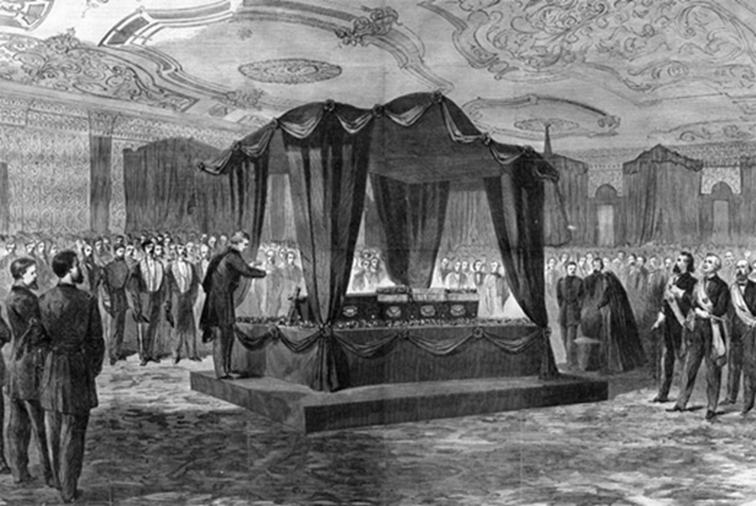
Fun Halloween
Hauntings

Slide 6
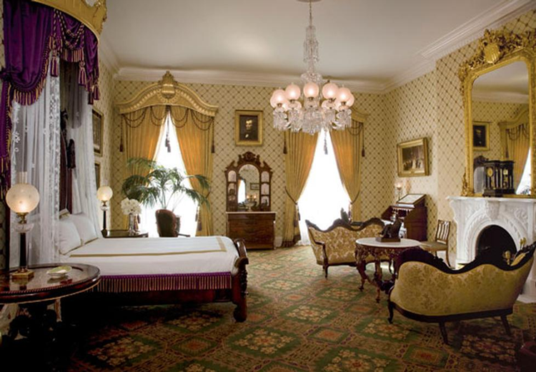
The Lincoln bedroom…

Slide 7
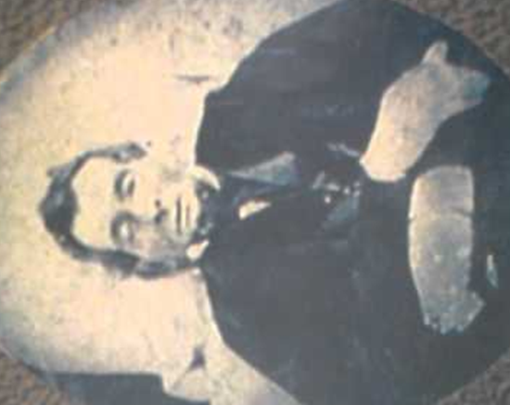
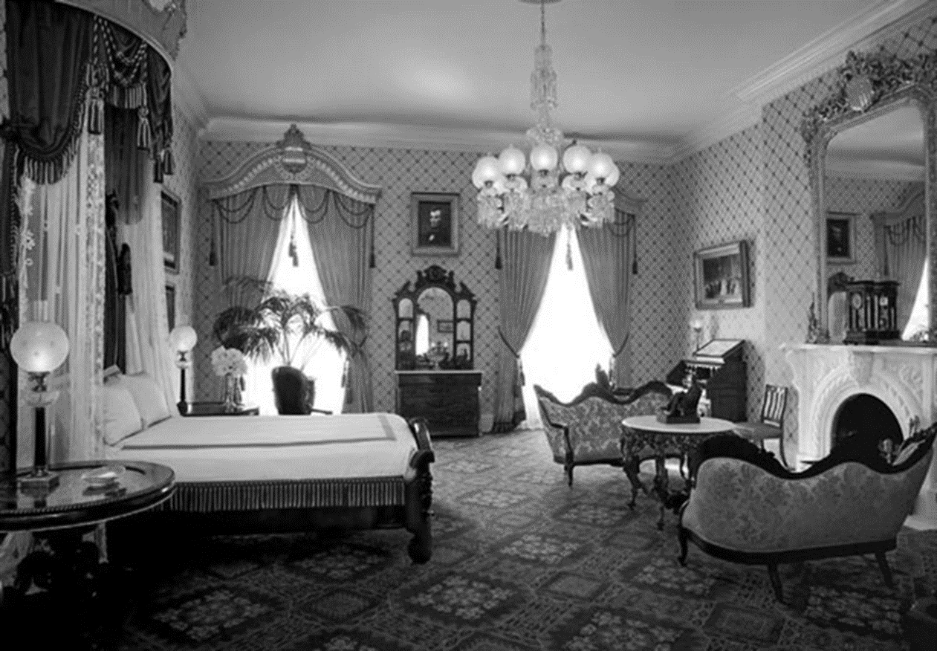
Willie Lincoln died in this room.
The autopsy on Abraham Lincoln had been performed in this room.
This was also the room in which President Truman’s mother died.

Slide 8
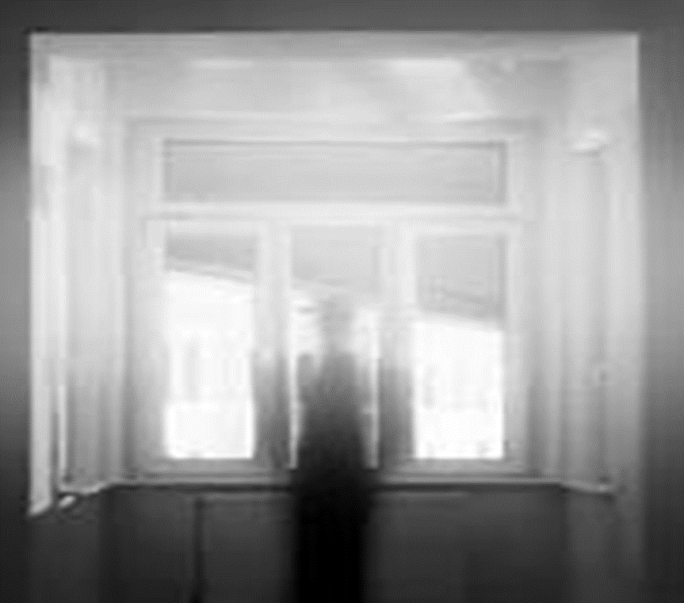
President Reagan’s daughter (Maureen) and her husband used to stay in the Lincoln Bedroom when they visit the White House.
Her husband woke up and saw a transparent figure standing at the bedroom window looking out. Then it turned and disappeared…
Maureen woke up one morning and saw the same figure standing at the window looking out. She could see the trees right through it. Again it turned and disappeared.'
President Reagan’s dog, Rex, had twice barked frantically in the Lincoln Bedroom and then backed out and refused to set foot over the threshold.

Slide 9
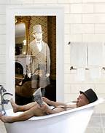

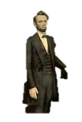
Half a dozen presidents and as many first ladies have reported ghostly happenings in the White House. It's not just the ghost of Lincoln that they see, although he tops the list.
He caused Winston Churchill, who was coming out of the bathroom naked but for a cigar when he encountered Lincoln, to refuse to sleep there again.
And Abe so startled Queen Wilhelmina of the Netherlands that she fell into a dead faint when she heard a knock on the door and opened it to find Lincoln standing there.

Slide 10
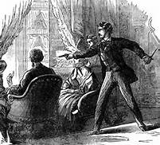
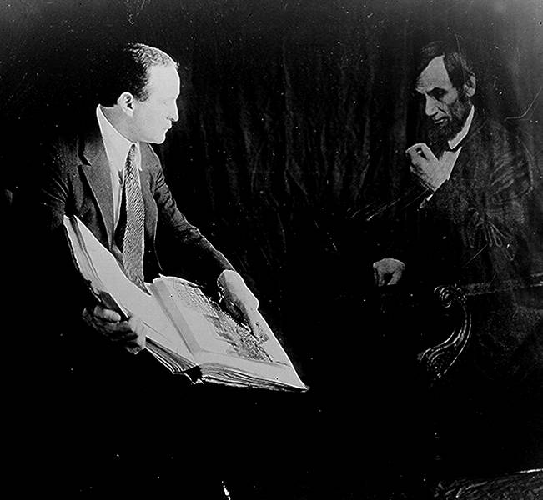
Lincoln himself told his wife he dreamt of his own assassination three days before it actually happened.
Calvin Coolidge's wife reported seeing Lincoln's ghost standing at a window of the Oval Office, hands clasped behind his back gazing out the window (just as Reagan's daughter saw a figure in a similar pose.)
Franklin Roosevelt's valet ran screaming from the White House after seeing Lincoln's ghost.
Eleanor Roosevelt, Ladybird Johnson and Gerald Ford's daughter Susan all sensed Lincoln's presence near the fireplace in the Lincoln Bedroom.

Slide 11
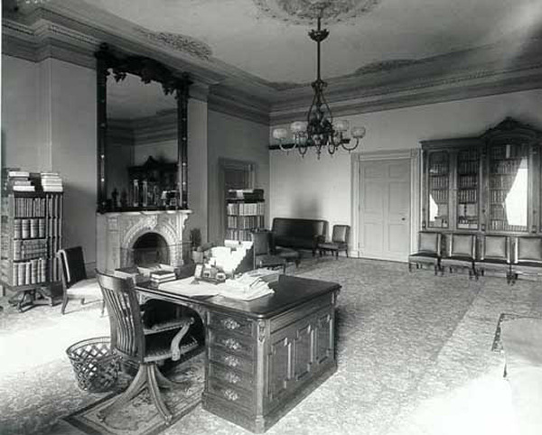
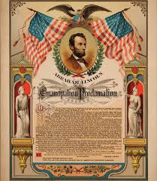

Slide 12
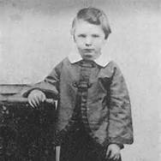
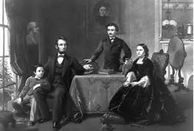
It's well known that Abraham Lincoln and his wife held séances in the White House, attempting to contact the spirit of their son Willie, who died there and who has been seen walking the halls.

Slide 13
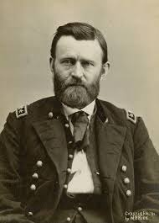
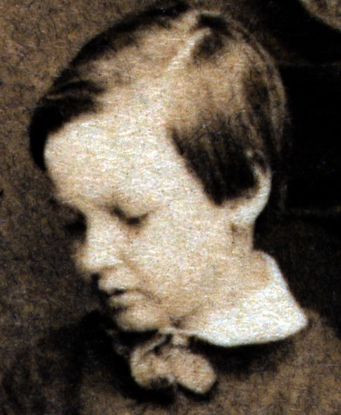
During the administration of Ulysses S. Grant
A member of the household staff claimed to have seen Willie Lincoln and to have conversed with his spirit.

Slide 14
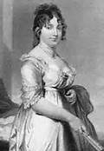
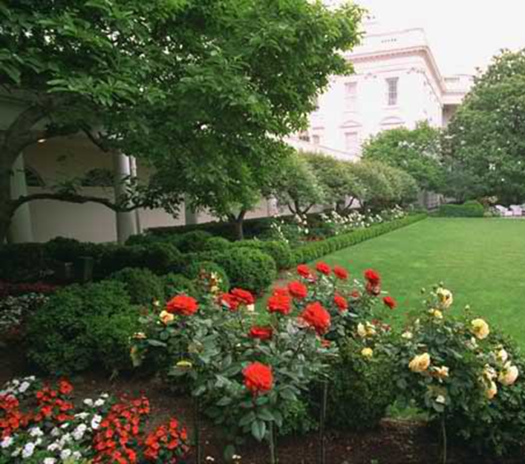
Other Ghostly Sightings at the White House:
The ghost of Dolley Madison, wife of James Madison, appeared often in the Rose Garden, which she had built and planted.
When Mrs. Woodrow Wilson occupied the White House, she ordered gardeners to dig up the familiar Rose Garden.
They never turned a spade. The men fled after seeing her ghost!!
Not a flower was disturbed and Dolley’s garden continues to bloom today as it has for nearly two centuries.

Slide 15
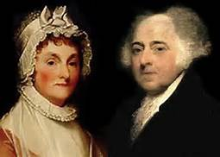
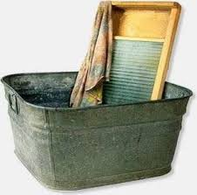
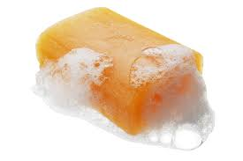
Other Ghostly Sightings at the White House:
Abigail Adams' ghost has been seen hanging laundry in the East Room -- she appeared frequently during the
Taft administration and as late as 2002 and is often accompanied by the smell of laundry soap.

Slide 16
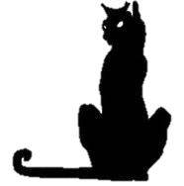
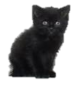
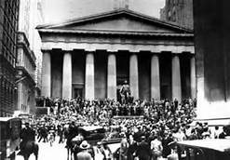
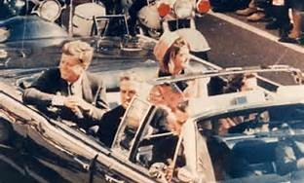
There is even reportedly a Demon Cat in the White House basement that is rarely seen.
When the cat does appear, it is foretelling a national disaster.
While the Demon Cat may at first look like a harmless kitten, it grows in size and evil the closer one gets.
A White House guard saw it a week before the stock market crash of 1929
It was also reportedly seen before Kennedy's assassination in 1963.

Slide 17
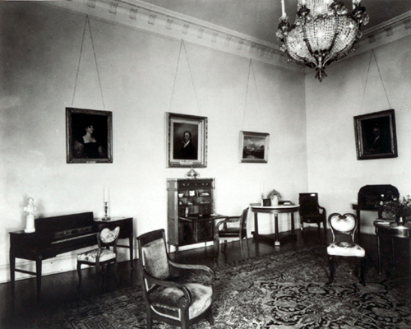
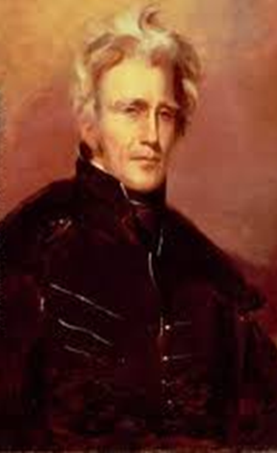
Twenty years after Jackson’s death, Mary Todd Lincoln, a devout believer in the spirit world, told friends that she’d heard him stomping through the White House corridors and swearing.
The Rose Room is believed to be one of the most haunted spots in the White House.
It contains Andrew Jackson’s bed, and if we are to believe testimony of those who have felt his presence, “Old Hickory” himself still dwells in his former bed chamber

Slide 18
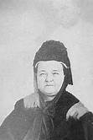
Fun With Pictures:
Mary Todd Lincoln after the death of Abraham

Slide 19
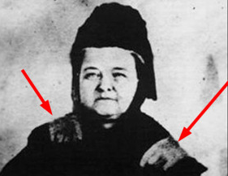
Fun With Pictures:

Slide 20
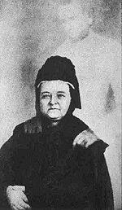
Creepy….

Slide 21
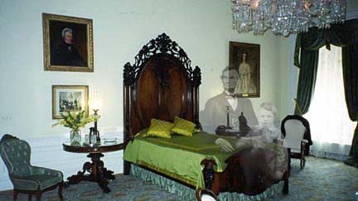

Slide 22
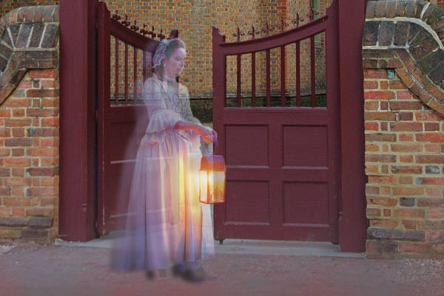
Colonial Williamsburg Ghost Walk Tours…
Colonial Ghosts is a walking ghost tour ranked as one of the Top 10 Ghost Tours in the US by US City Traveler, placing for Williamsburg, Virginia. We feature late night 11PM and 8PM tours. Our tours include indian burial grounds, witches, stories of murder, war, and betrayal across hundreds of years in Williamsburg. If you want a ghost tour, you need it with Colonial Ghosts.

Slide 23
Resources:
http://www.history.com/topics/halloween/haunted-historic-places
http://www.colonialwilliamsburg.com/plan/calendar/tavern-ghost-walk/

